Slide 1
Multiplex Movie Booking App
Team – Sreenisha (teamLeader)
Karthik
Karthikeyan
Adarsh
Manikanta

Slide 2
Outline
Problem Statement
Objective
Microservices
Project Overview
Onboarding-Architecture
Project Flow
Technology and Tools used
Conclusion

Slide 3
Problem Statement
X wanted to watch a movie that has recently been released they have been waiting for but X doesn’t want to manually call and check if movie is available in theaters
Y wants to add his multiplex and add movies to it but he doesn’t know where to market this information.

Slide 4
Objective
To provide a simple and fun user experience to watch your favorite movies in your select watching experience.
To provide an easy-to-use place for multiplex owners to display their information to customer.

Slide 5
Microservices

Slide 6
Project Overview

Slide 7
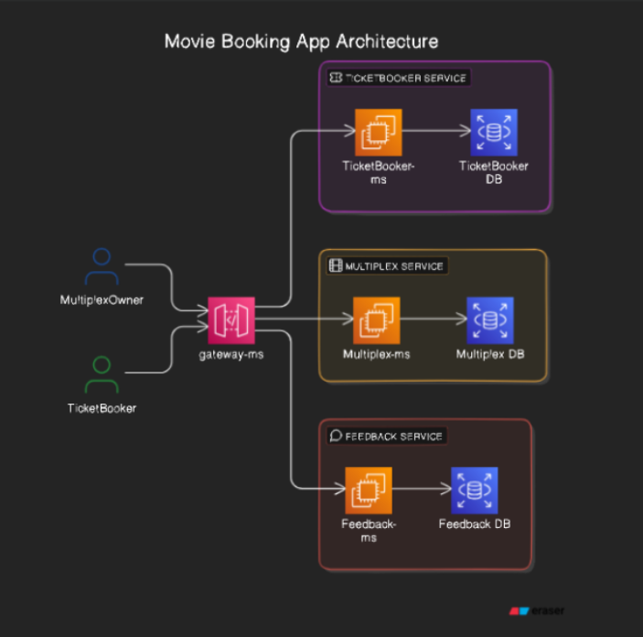
Project Overview

Slide 8
Project Flow

Slide 9
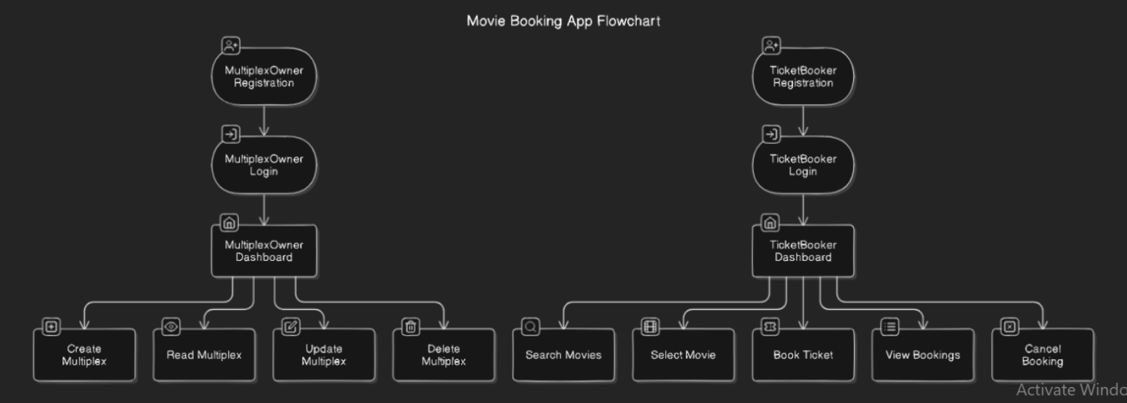
Project Flow

Slide 10
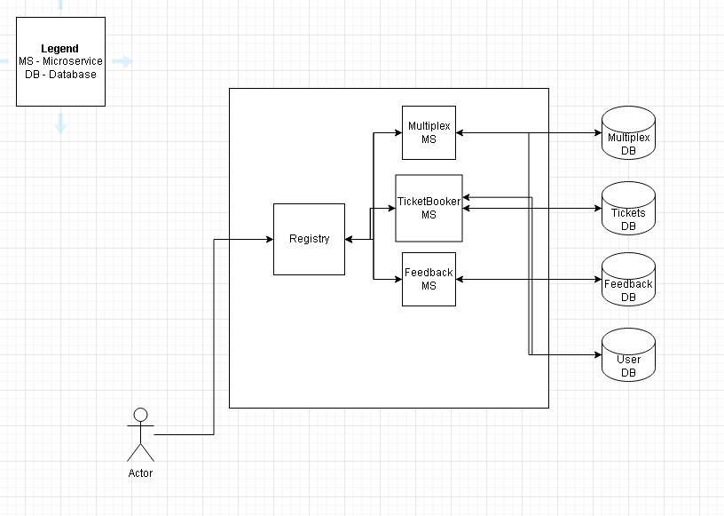
Microservice Architecture

Slide 11
Onboarding Architecture

Slide 12
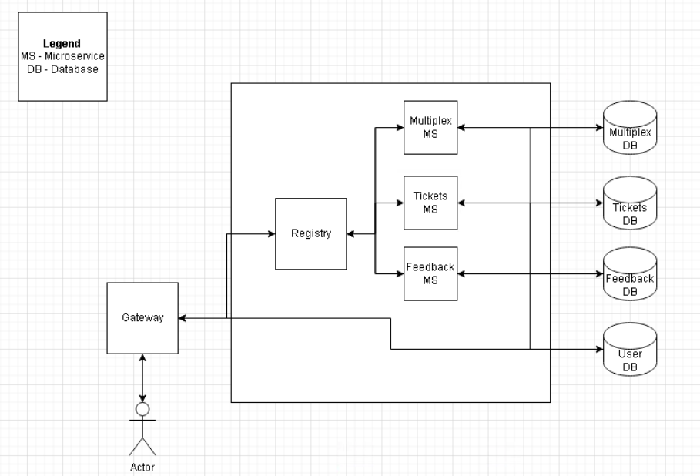
Microservice Architecture

Slide 13
Technology And Tools Used

Slide 14
Technology and Tool Used
Java
SpringBoot
React
Kafka
Postman

Slide 15
Conclusion
This movie booking app helps the user(TicketBooker) to book the latest movies with ease.
It helps the user(Multiplex) for CRUD operations for Multiplex, Movies, Screens.

